Slide 1

Week 03 : lecture 05
Computer Organization and Assembly Language
Quiz 01 on Rescheduled class Friday 24th Oct I.A

Slide 2
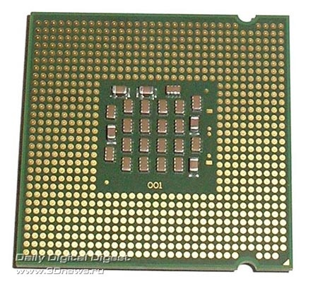
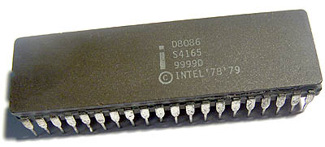
Microprocessor Vs Microcontroller
What is a Microprocessor?
A microprocessor is an electronic computers central processing unit (CPU) made from miniaturized transistors and other circuit elements on a single semiconductor integrated circuit (IC).
It performs arithmetic, logic and control operations. It contains a control unit, an arithmetic & logic unit, registers and links to store data and connect to peripherals.
What is a Microcontroller?
Dedicated to performing one task. Integrates the memory and other features of a microprocessor.

Slide 3
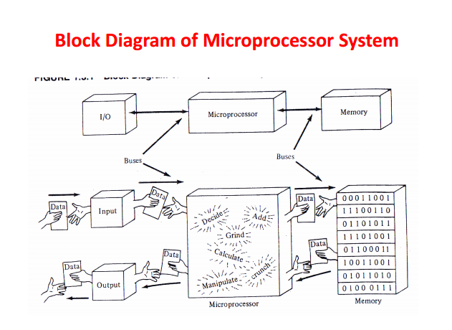

Slide 4
Microcomputer System
Interface
Memory Module
Timing
Microprocessor
(CPU)
Bus Control logic
Interface
Mass Storage Device
Interface
I/O Devices

Slide 5
Microprocessor Architecture : Register file
Microprocessor
M E M O R Y
Register File
Address
ALU
Data

Slide 6
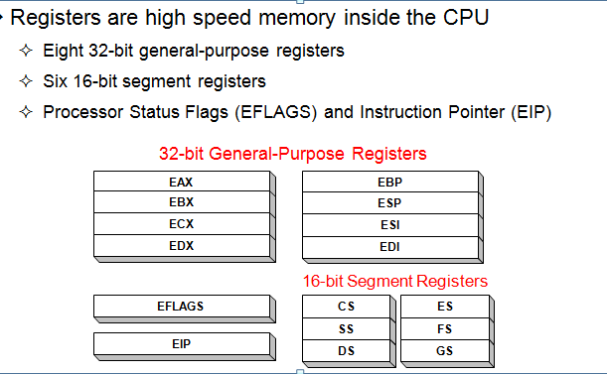
Microprocessor Architecture : Register file

Slide 7
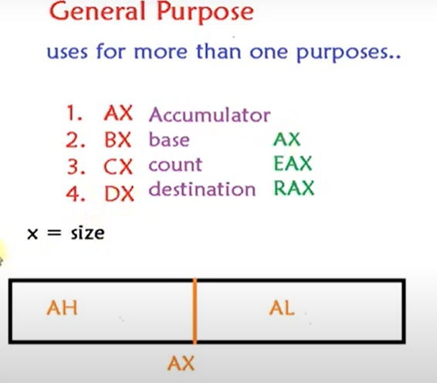
Microprocessor Architecture : Register file

Slide 8
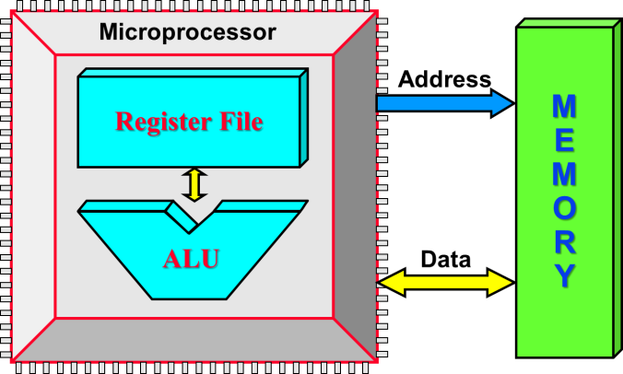
Multi purpose Registers :
 8 Bits 
 8 Bits 
Accumulator Register
AH
AL
AX
Base Register
BH
BL
BX
Count Register
CH
CL
CX
Division Register
DH
DL
DX

Slide 9
Multi purpose Registers :
Multipurpose registers:
8-bit register names used with register addressing: AH, AL, BH, BL, CH, CL, DH, and DL.
16-bit register names: AX, BX, CX, DX, SP, BP, SI, and DI.
80386 and above
32-bit register names are: EAX, EBX, ECX, EDX, ESP, EBP, EDI, and ESI.
64-bit mode register names are: RAX, RBX, RCX, RDX, RSP, RBP, RDI, RSI, and R8 through R15.
Note :Mixing of registers not allowed in assembler (Error)

Slide 10
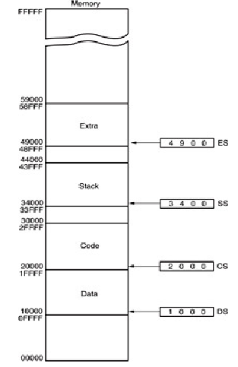
Multi purpose Registers :
←⎯ 16 Bits ⎯→
Code Segment
CS
Data Segment
DS
Extra Segment
ES
Stack Segment
SS

Slide 11
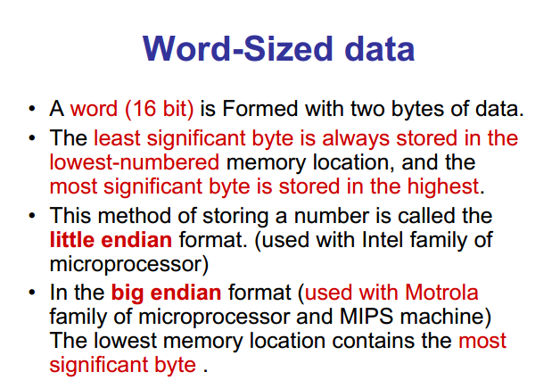

Slide 12
Instruction Format :
Instruction Format
Mnemonic /abbreviation
One or More Operands
Machine Code
Binary form 1 , 0’s
Mnemonic /
Abbreviation Operands
Opcode Mode Operands

